Slide 1
Evaluating Demographics, Start Times, and Scan Rates in PC MBB, WBB, and MHKY
Colin Fitzgibbons, William Healey, Liam Slattery, Jack Wright, Neil Pepin

Slide 2
General Findings
Start Times, Rivalries, and Win Percentage Impact on Ticket Sales and Attendance

Slide 3

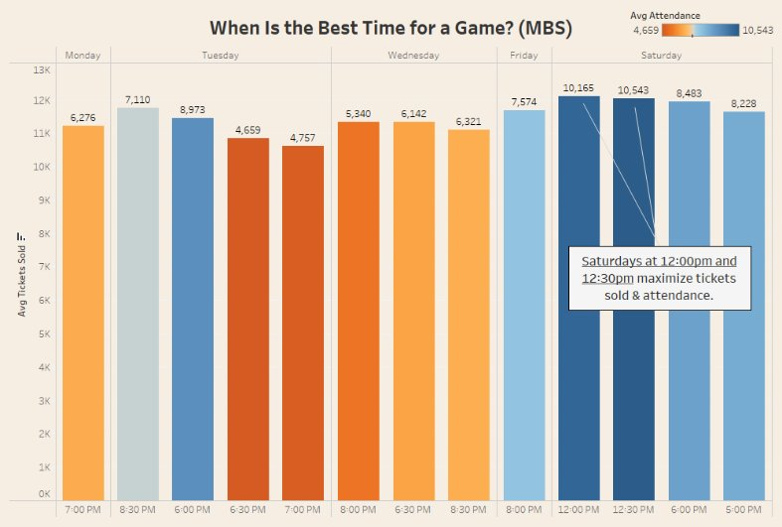

Slide 4
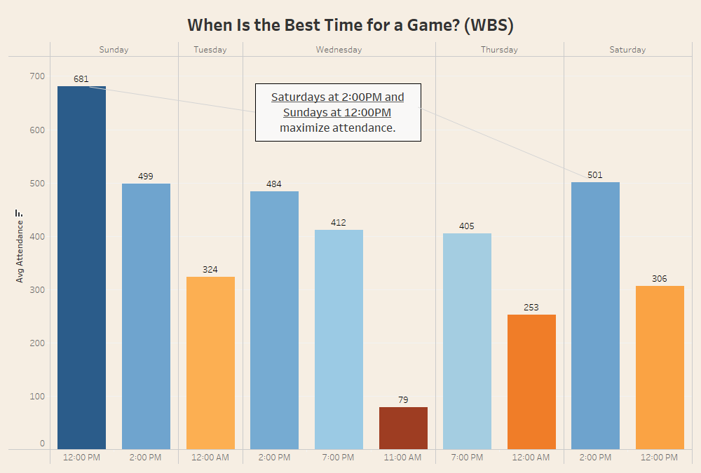

Slide 5
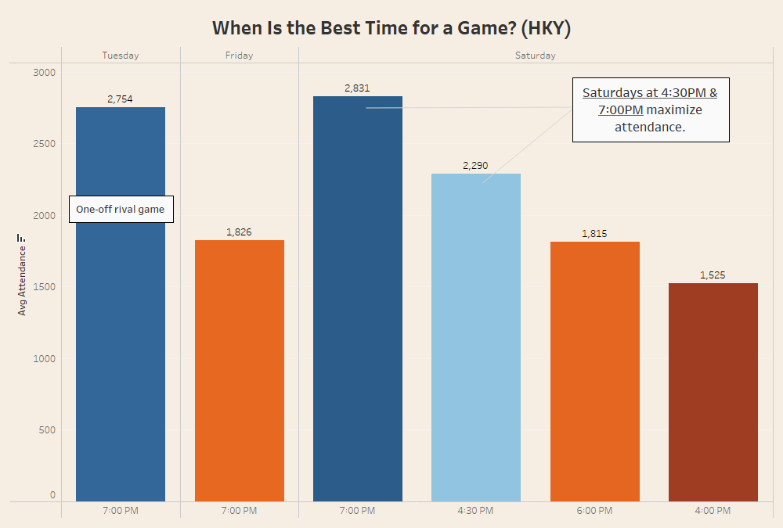

Slide 6
Actionable Steps to Optimize Game Times
MBS: Prioritize Saturday start times at 12:00 PM and 12:30 PM
WBS: Prioritize Saturday at 2:00 PM and Sunday at 12:00 PM
HKY: Prioritize Saturday at 4:30 PM and 7:00 PM
Note: While start time appears to influence tickets sold and attendance, opponent quality plays a significant role as well. Run analyses with prior season's data and exclude rivalry games.

Slide 7
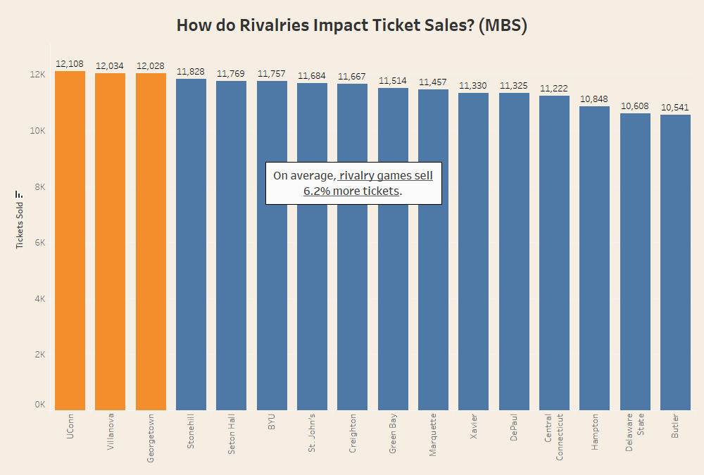

Slide 8
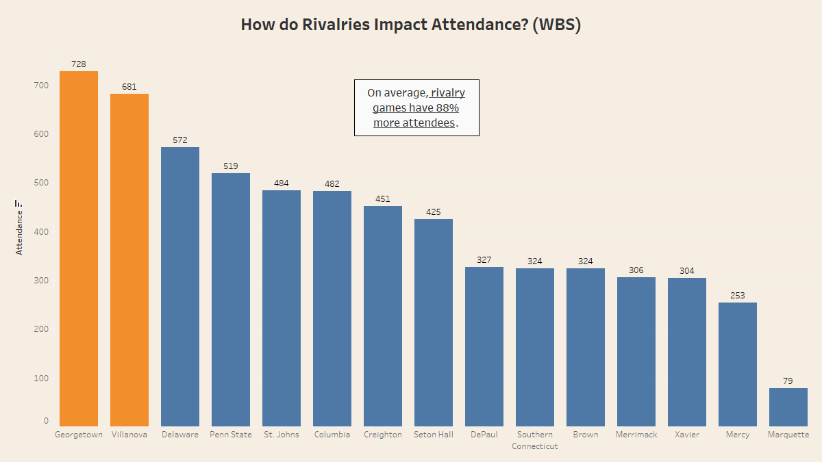

Slide 9
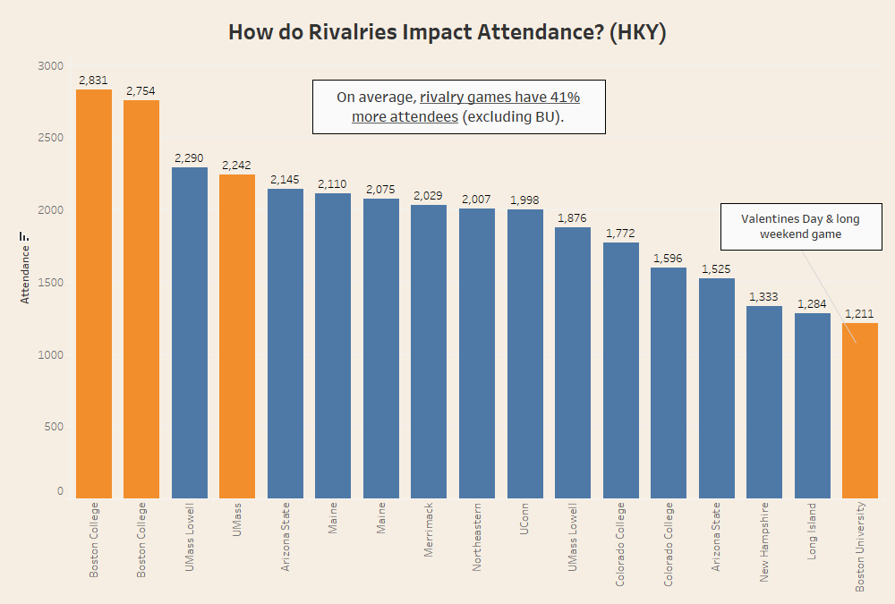

Slide 10
Rivalry Marketing Approach
Enhance promotion for confirmed rivalry games to maximize attendance and engagement
Position select opponents as rivals through marketing to generate additional interest, even if the rivalry is not firmly established. (Ex: UMass Lowel for hockey)

Slide 11
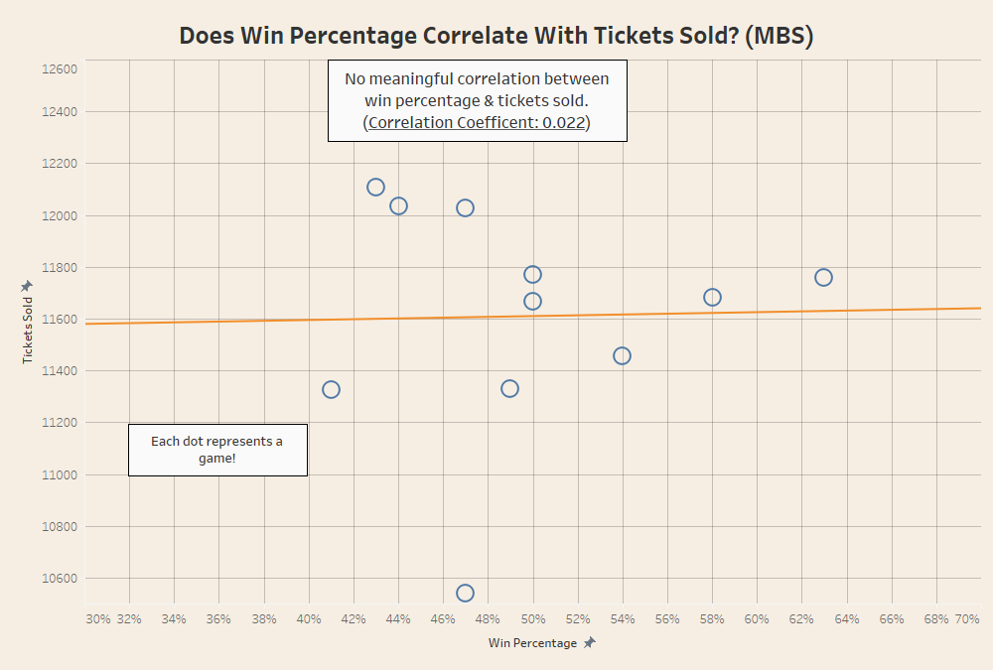

Slide 12
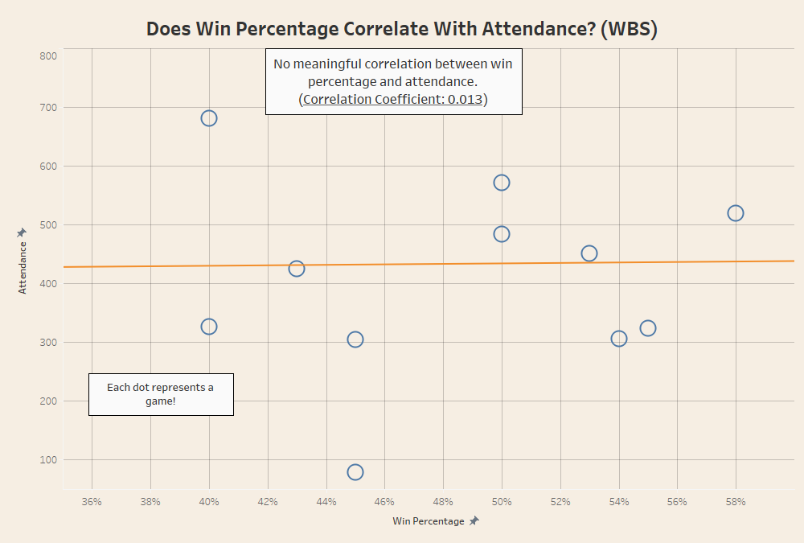

Slide 13
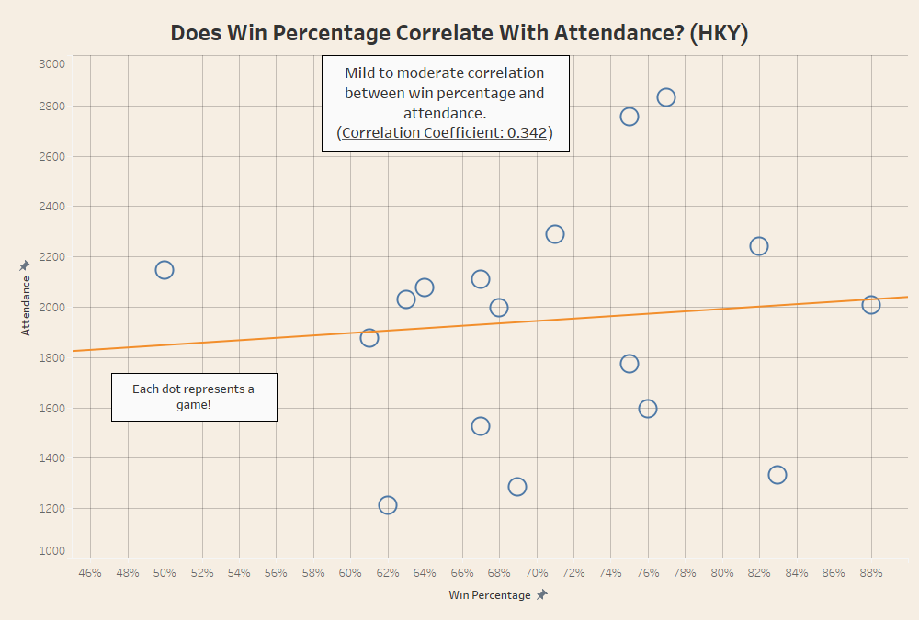

Slide 14
Potential Next Step
Rerun the same correlation analysis including data from prior seasons

Slide 15

Improving Family Engagement in Men's Basketball

Slide 16
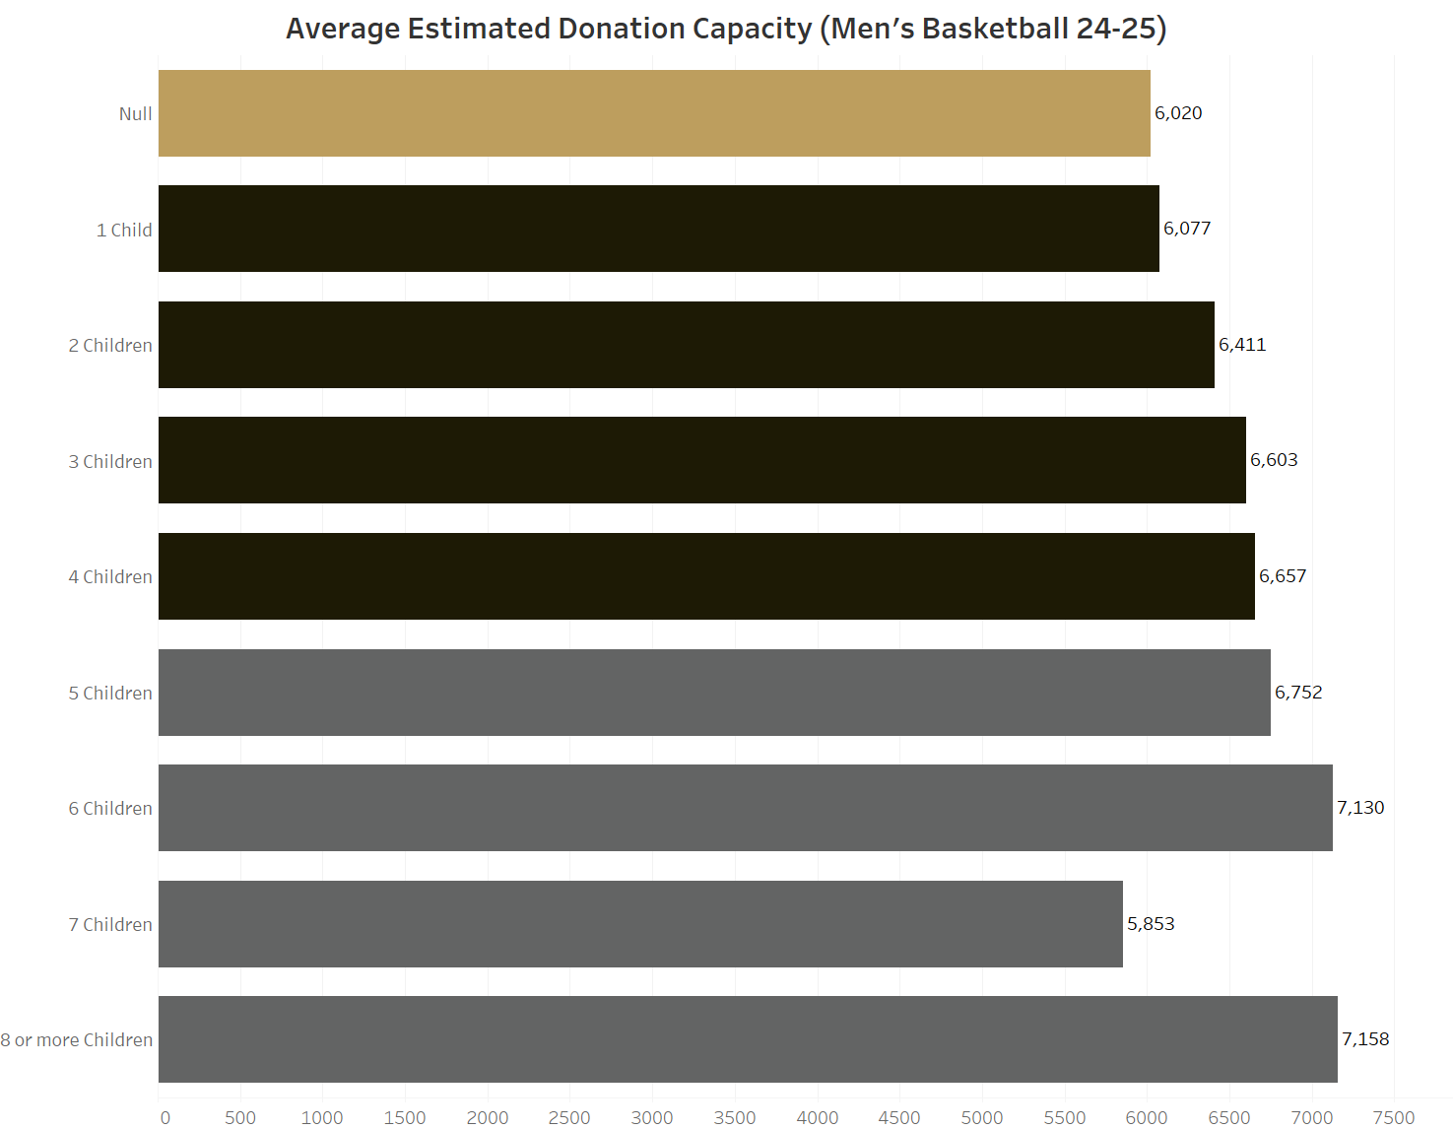
Notes:
Larger families, on average, have more capacity to donate. They're a valuable target demographic for driving revenue and creating generations of fans.
Cross referencing account ids from men's basketball scan logs with customer data from the appends

Slide 17
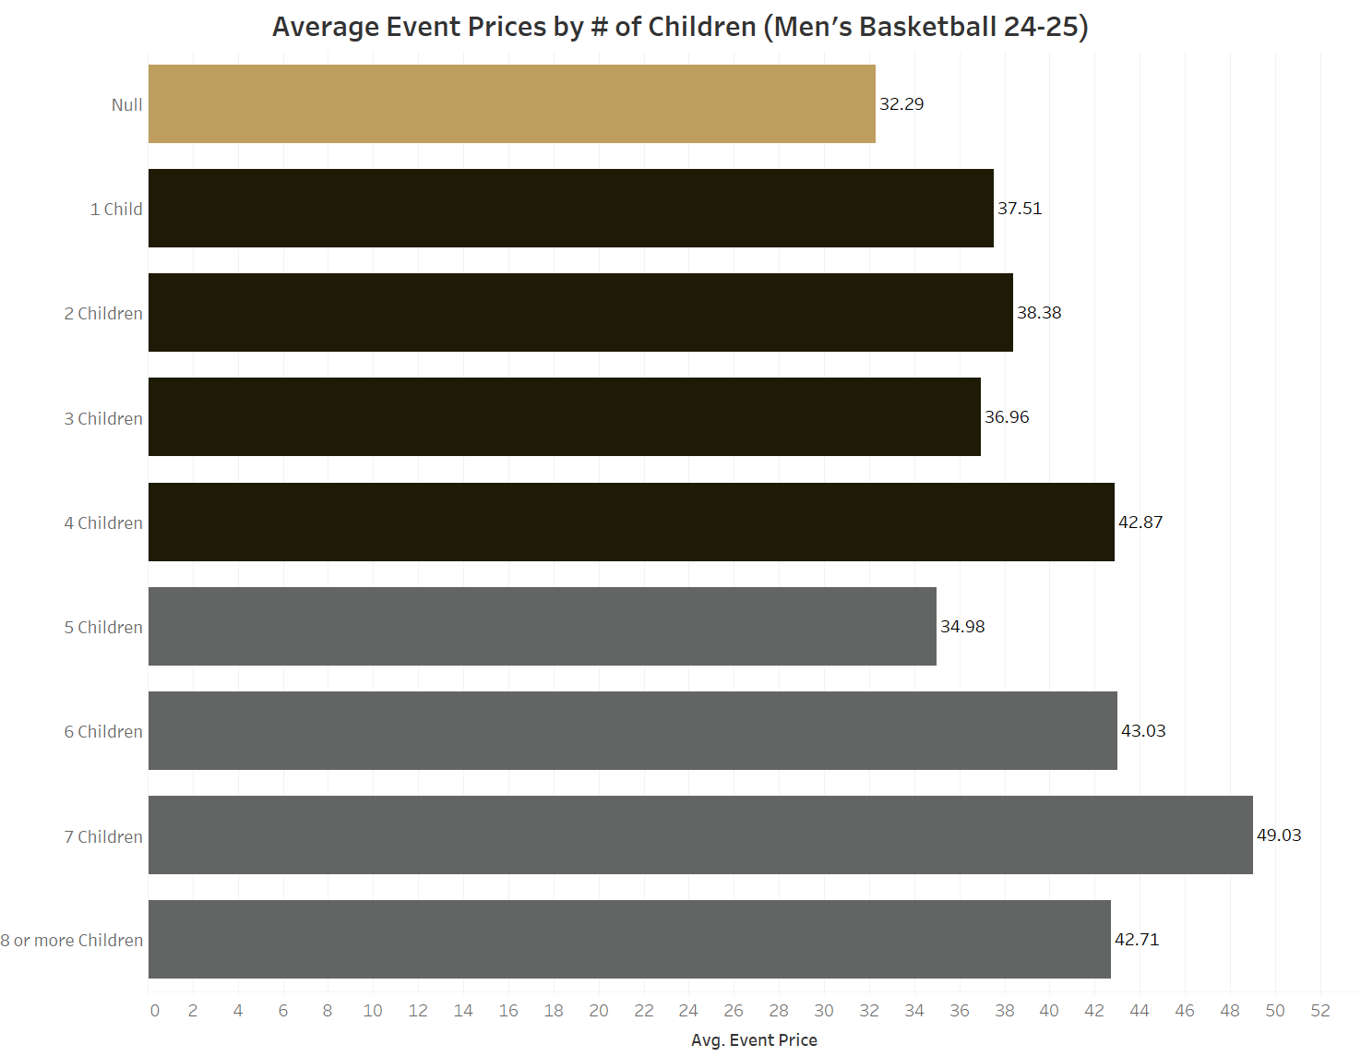
Notes:
They also tend to pay more, on average, for events. Just having one child accounts for over $5 in added average revenue.

Slide 18
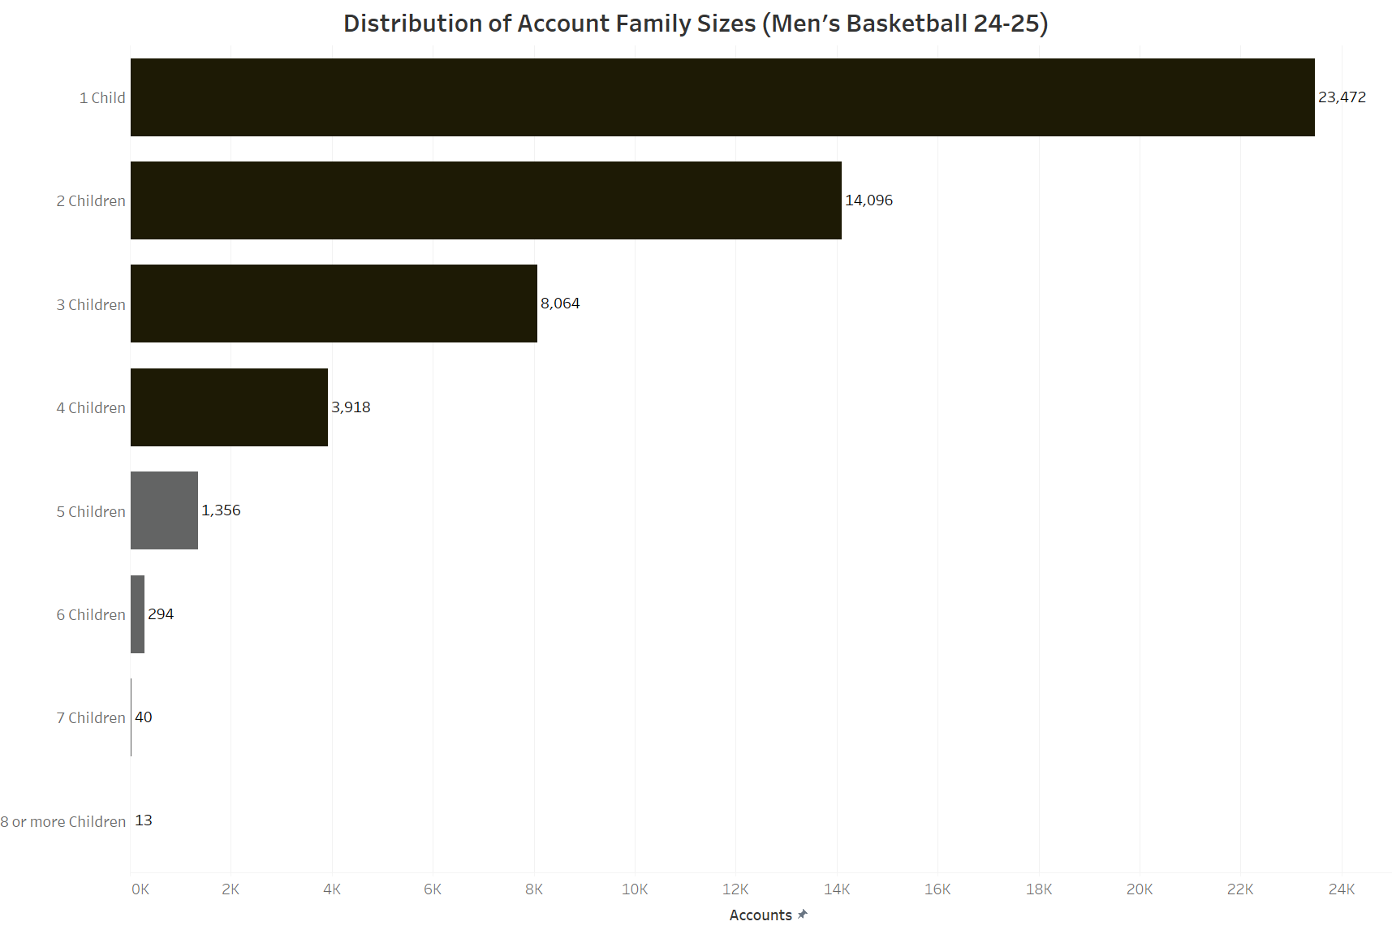
Notes:
In total, 23472 + 14096 +8064 + 3918 + 1356 + 294+40 = 51240
142148 Null, 193348 true sum
26.48% of accounts are family
Despite larger families donating the most on average, they're harder to come by in larger sizes. Families of between 1 and 4 children make up 96.7% of all known families in the account data.
How can we improve our family outreach to take further advantage of this interested demographic?

Slide 19
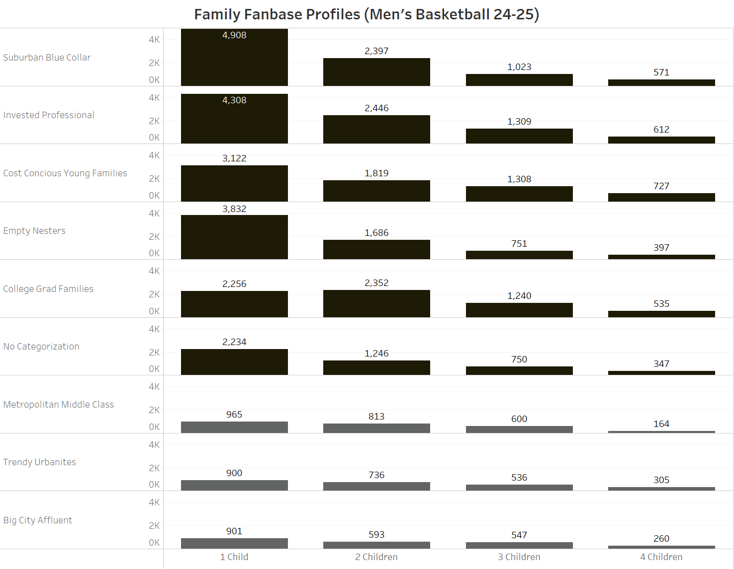

Slide 20
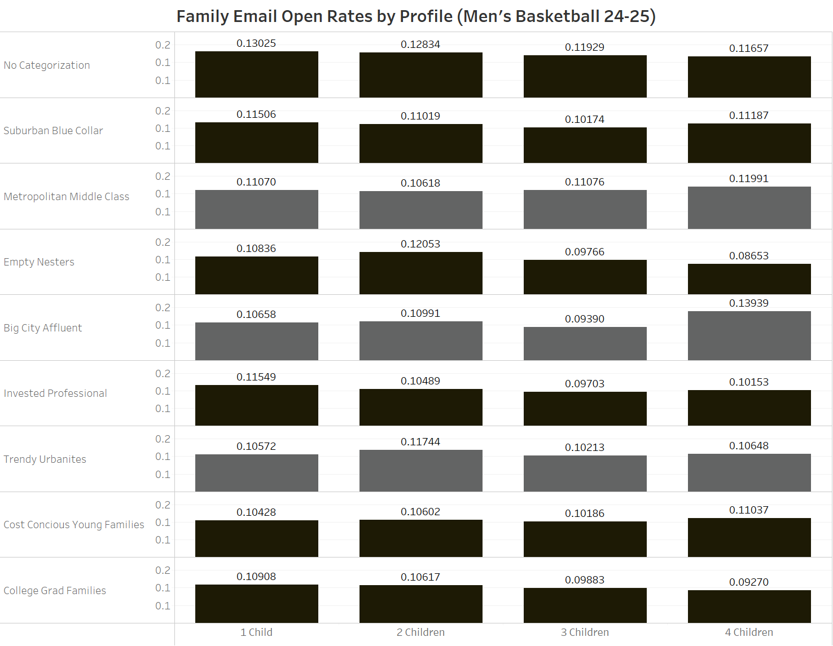

Slide 21
Actions for Improved Family Engagement in Men's Basketball
Email marketing has shown success for:
suburban blue collar
empty nesters
non-categorized account holders
Consider increasing family-oriented marketing towards these groups
For nonresponsive groups:
Invested Professionals
Cost-Conscious young families
College grad families
Consider alternative marketing means (print, SMS, social media)
To drive revenue for families, consider more family promotions
1-child families pay 1.16x null entries, so a 10% family discount would incentivize attendance while still paying more than a non-family

Slide 22
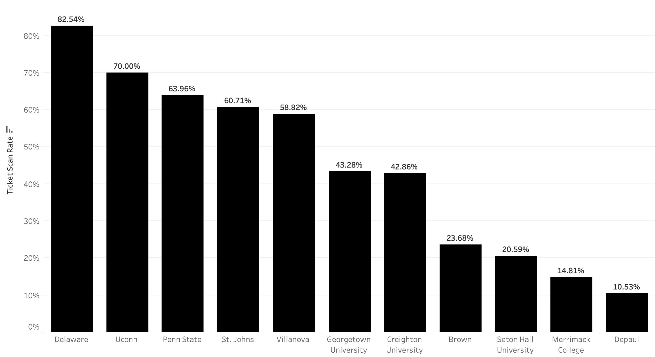
Women's Basketball Ticket Scan Rates

Slide 23
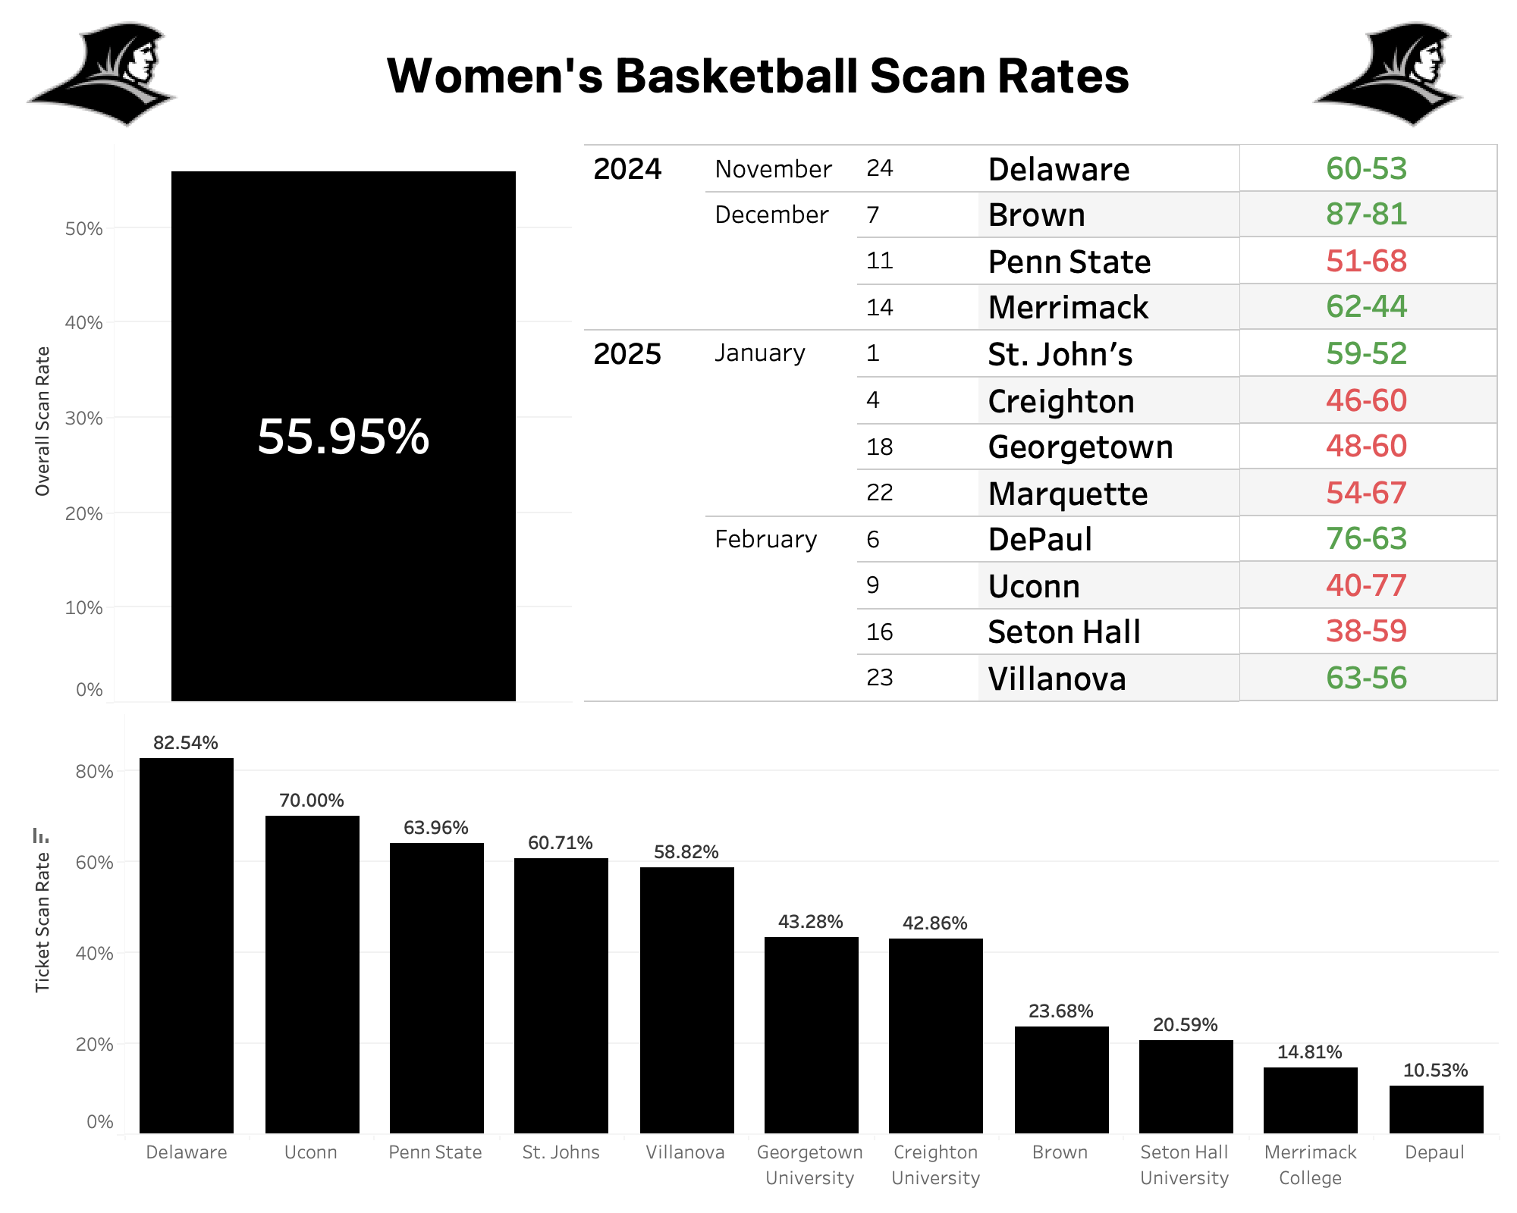
WBS Scan Rate Dashboard and Insights
1,904 Season Ticket Holders
Seat Manifest Data
1,875 Project Providence Donors
298 (16%) have GRMID
Overall scan rate of 56%
Sunday games held higher scan rates (67%)
February held highest scan rates behind Delaware game in November
Day of week contributed more than opponent names/scores

Slide 24
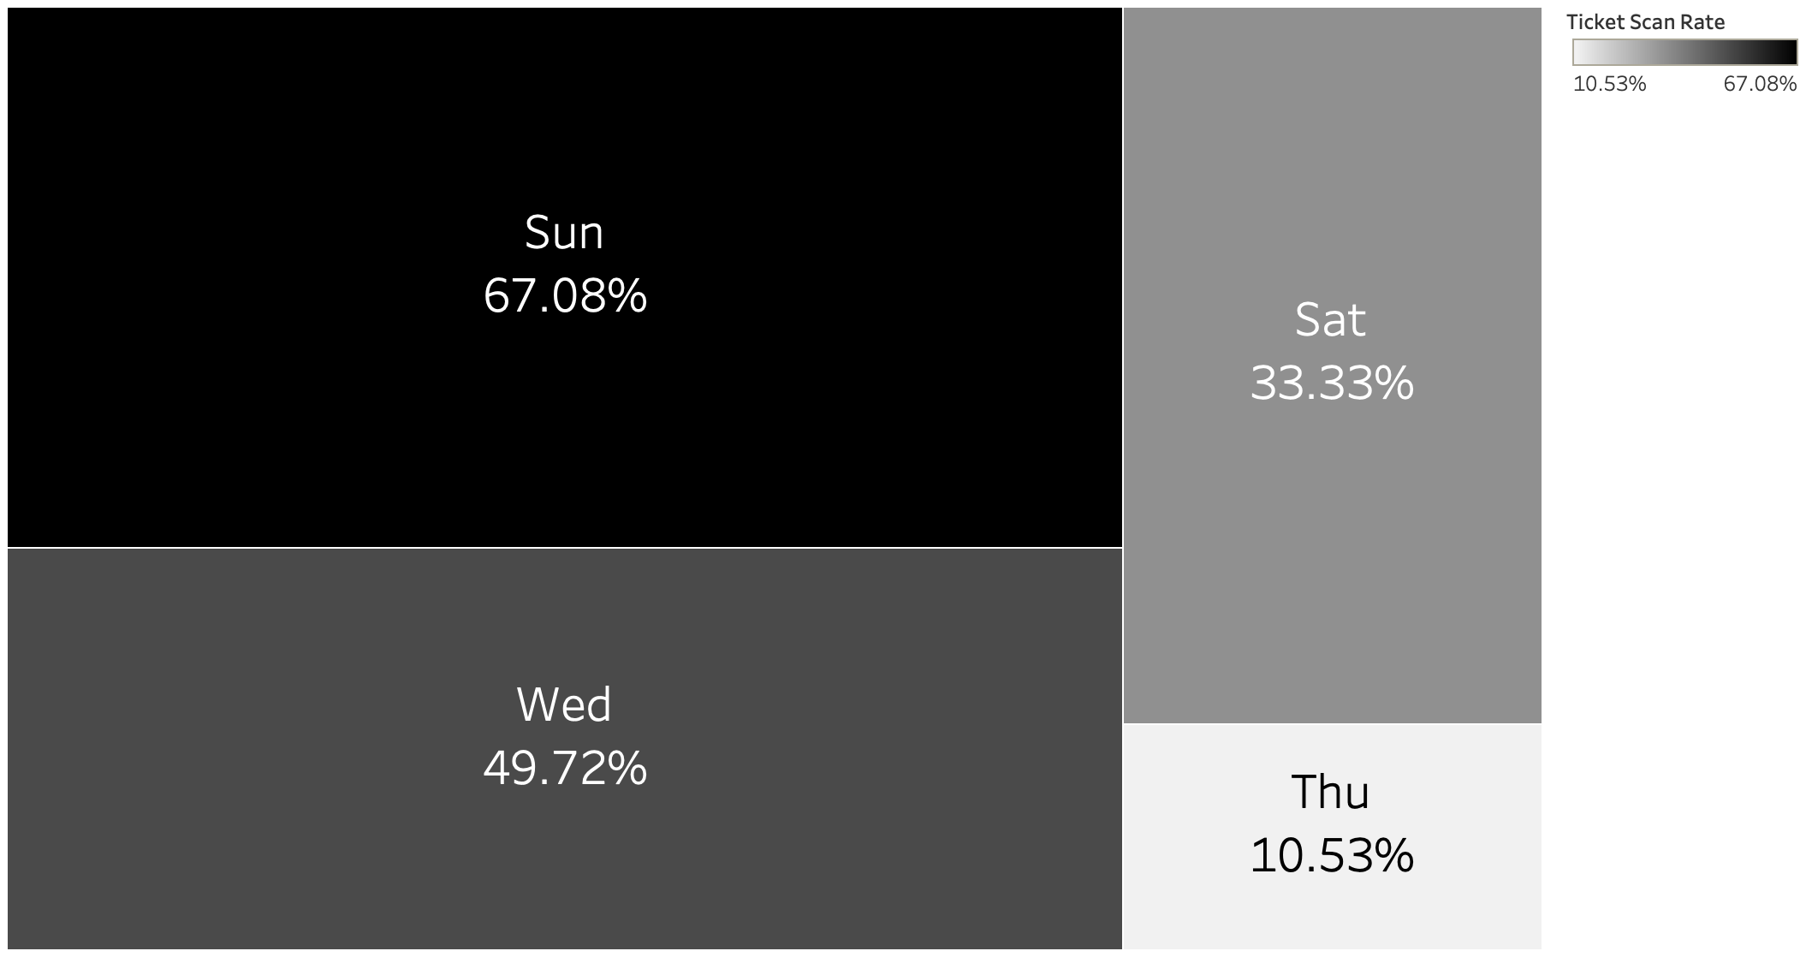
Women's Basketball DOW Scan Rates

Slide 25
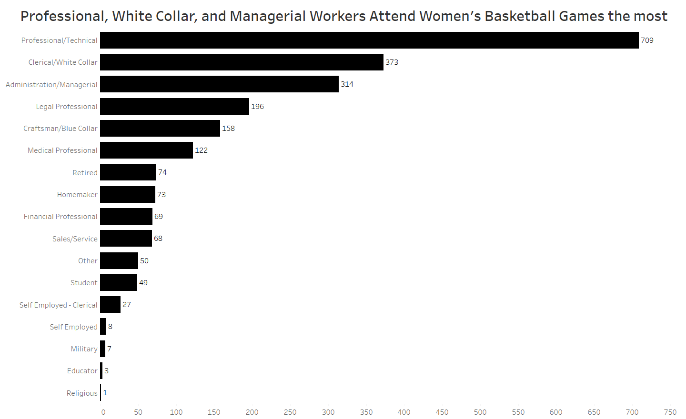

Slide 26
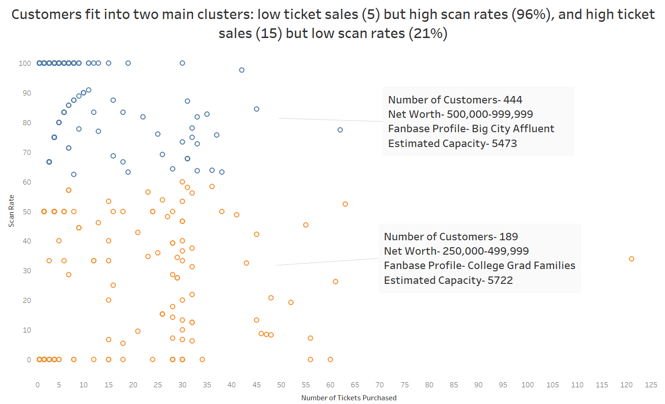

Slide 27
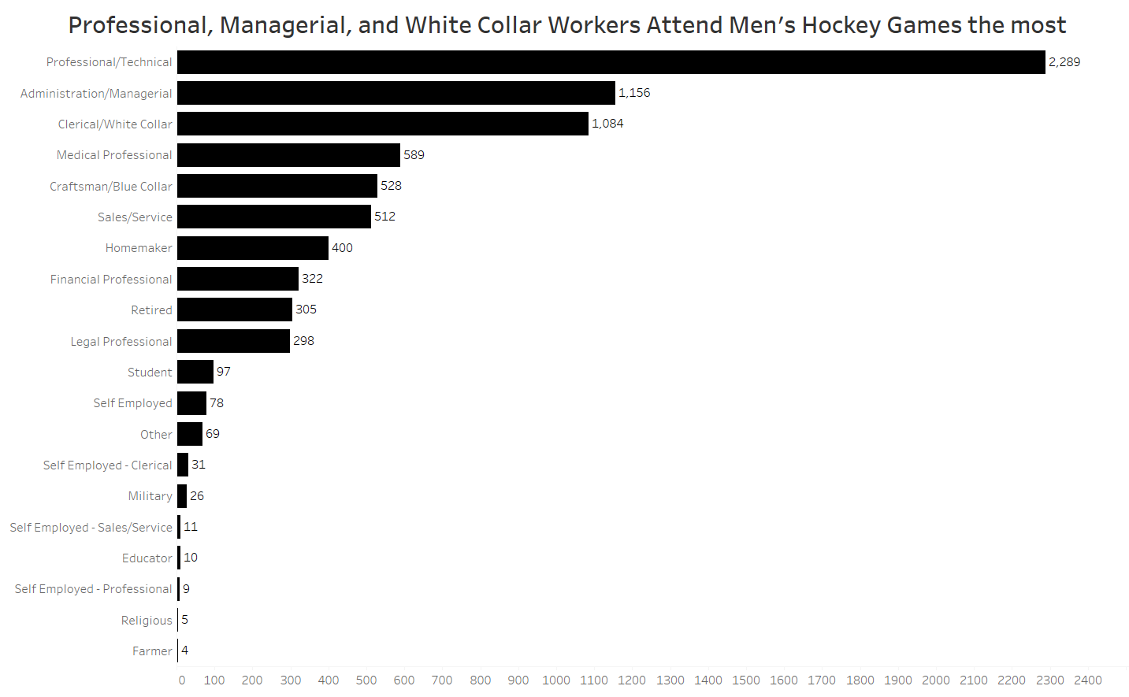

Slide 28
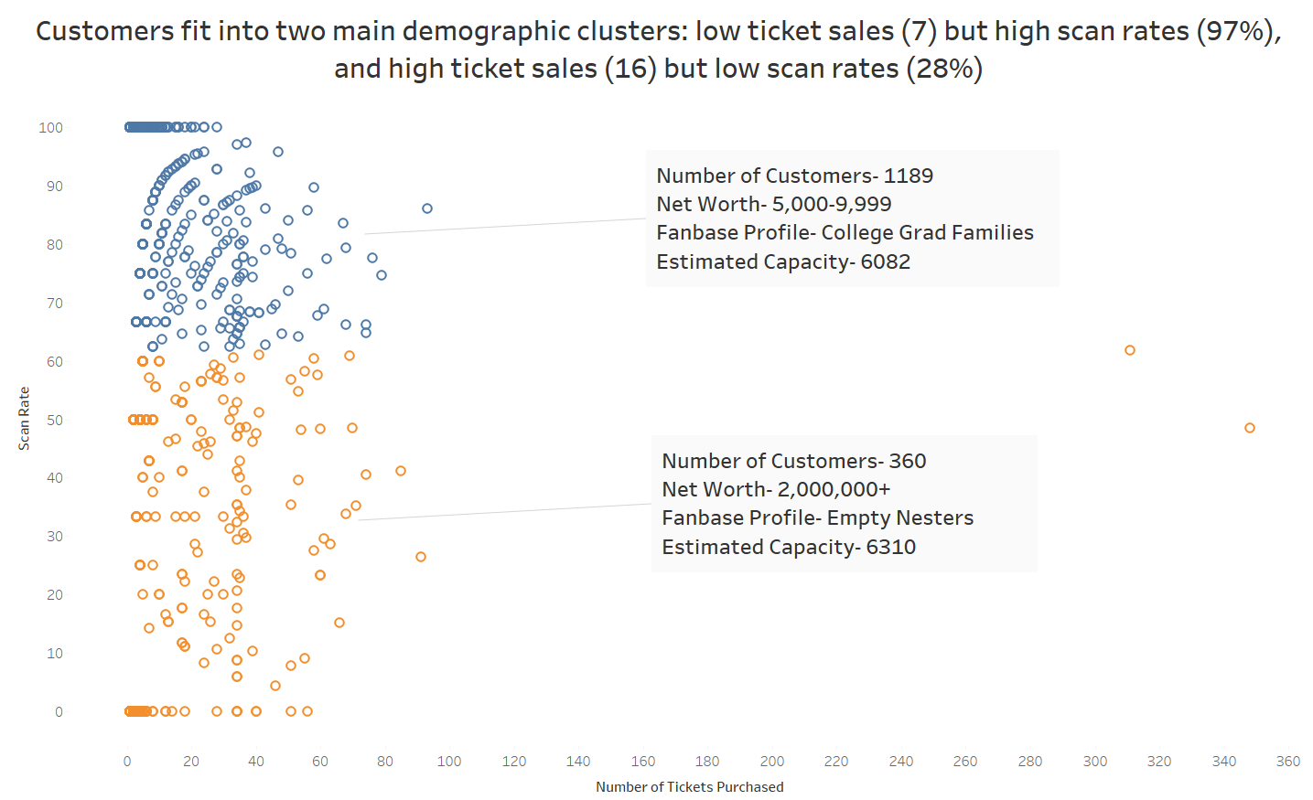

Slide 29
Marketing Techniques to Improve Revenue and Attendance
Target employees of specific companies
Citizens, Fidelity, Lifespan, etc
Provide promotional ticket deals- non rivalry games, 2nd games
Initiate partnerships or host networking events
Target cluster 1 fanbase with a ticket purchase reward structure
Target cluster 2 fanbase with a game attendance reward structure
Target Men's Hockey cluster 2 fans for greater donations

Slide 30
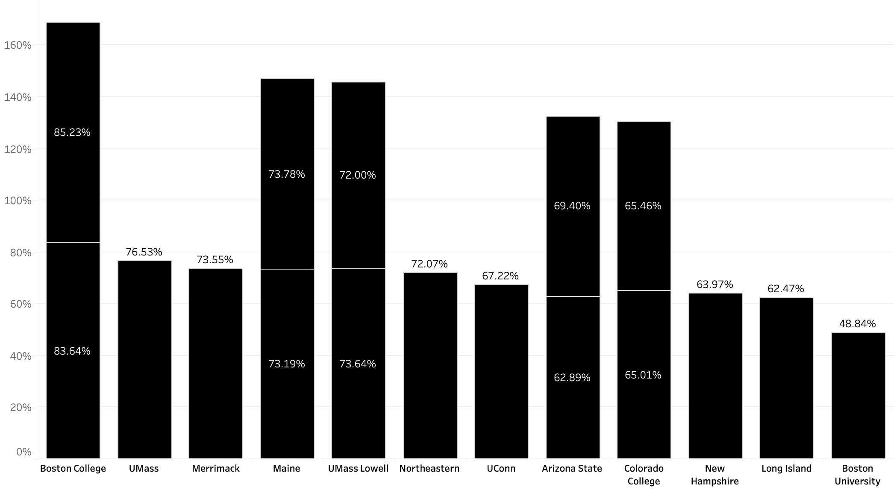
Men's Hockey Ticket Scan Rates

Slide 31
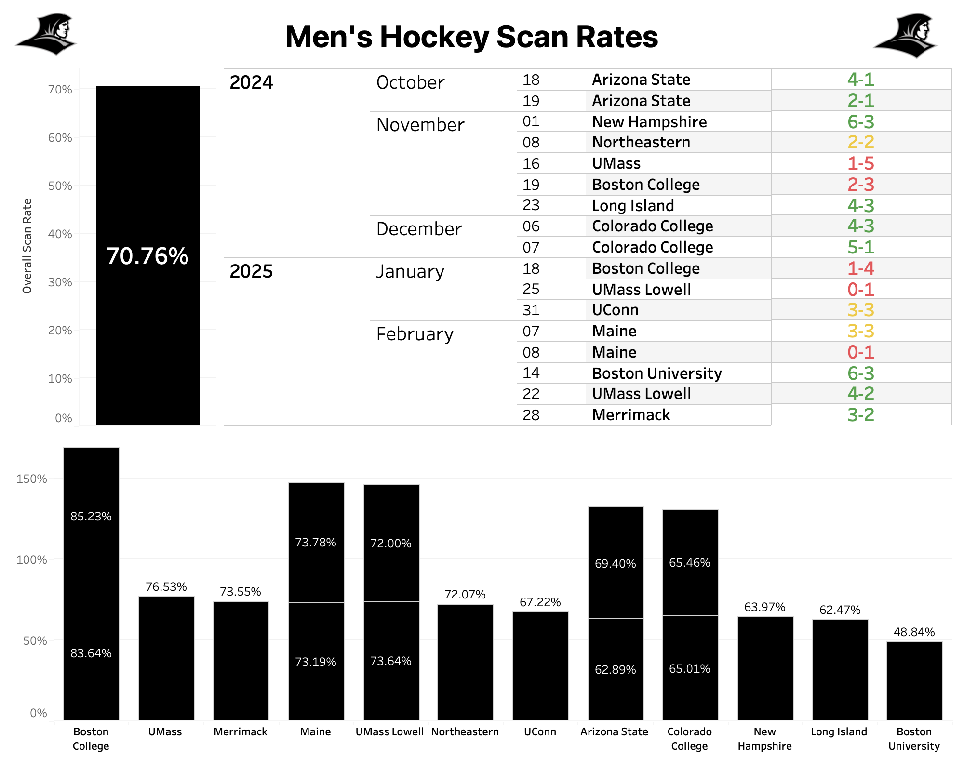
HKS Scan Rate Dashboard and Insights
84% scan rate across both Boston College games
Overall Scan Rate of 70.76%
Month of January showed highest scan rate at 76%
Most popular game day: Saturday (72%)
Exception of Boston College game on Tuesday
Overall, opponent names/heightened rivalries contributed greater

Slide 32
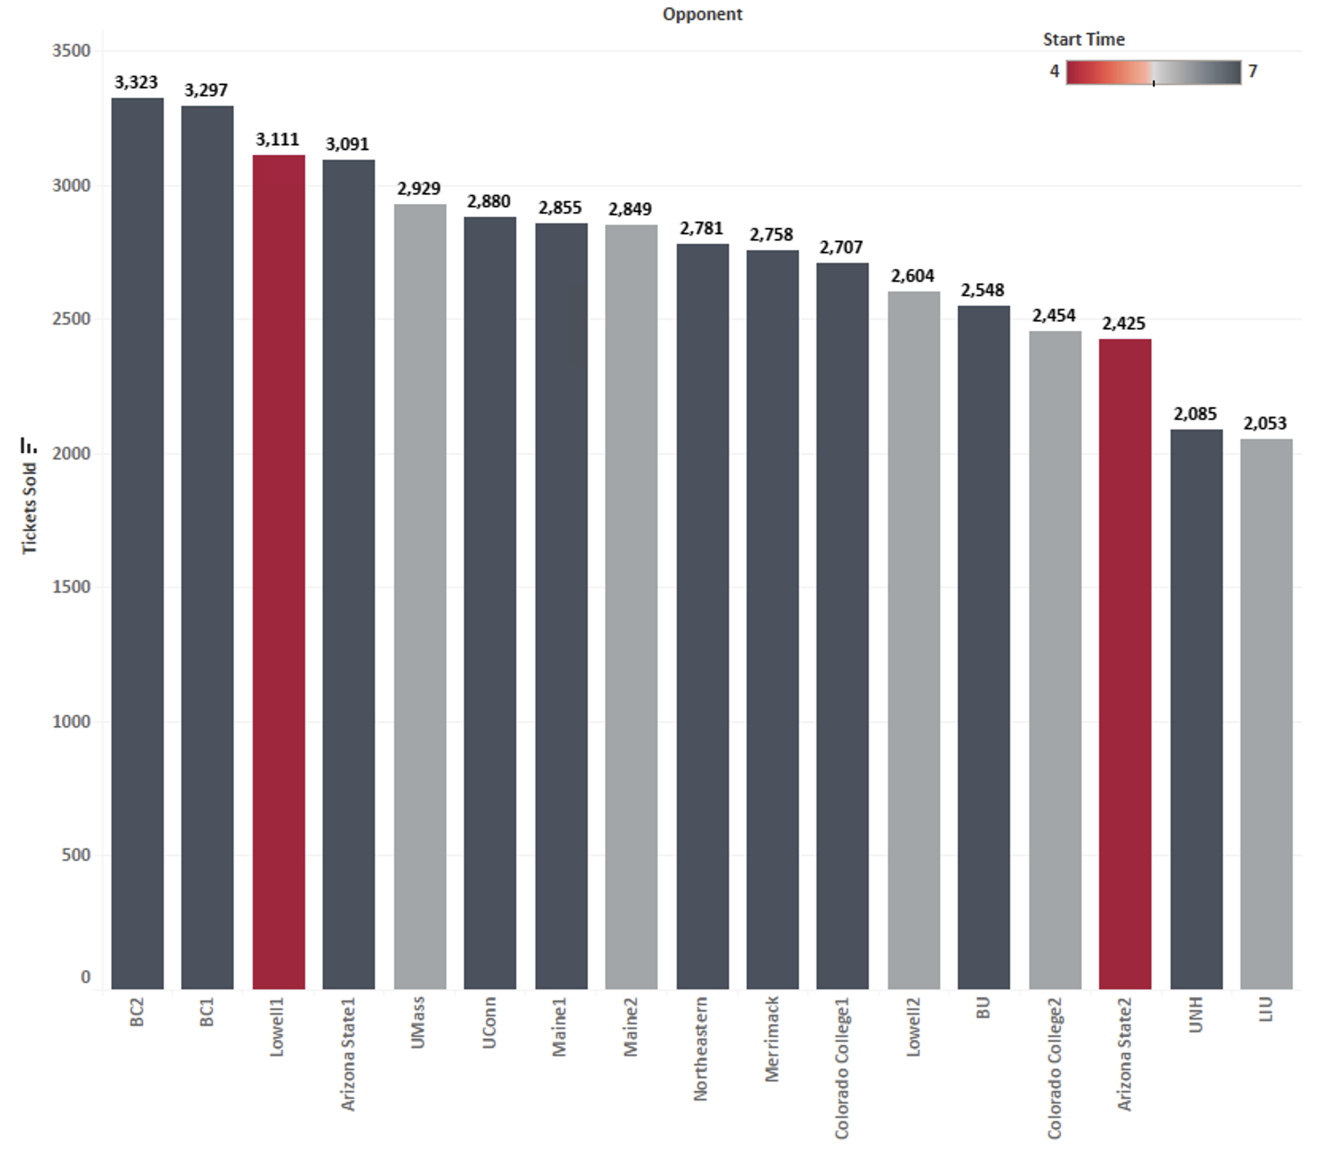
Men's Hockey Ticket Sales
Rivalries and high-participation special events drove highest sales
BC
Lowell/ASU
Low recognition opponents and school breaks resulted in lowest sales
LIU
UNH
Notes:
Lowell was youth hockey night, ASU was homecoming
LIU – Thanksgiving, UNH – Halloween

Slide 33
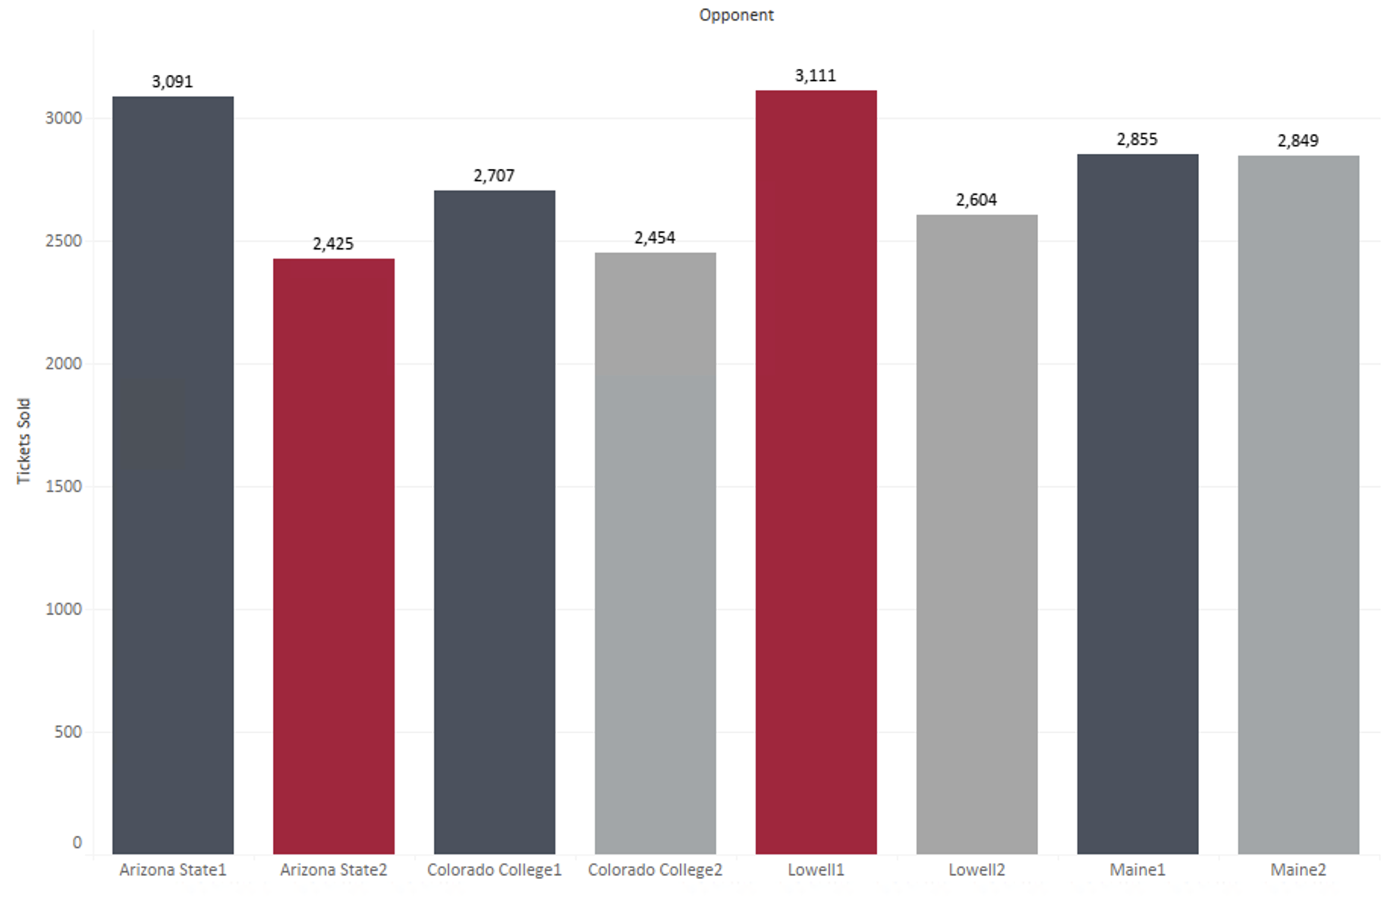
Men's Hockey Ticket Sales
Notes:
Lowell was youth hockey night, ASU was homecoming
LIU – Thanksgiving, UNH – Halloween

Slide 34
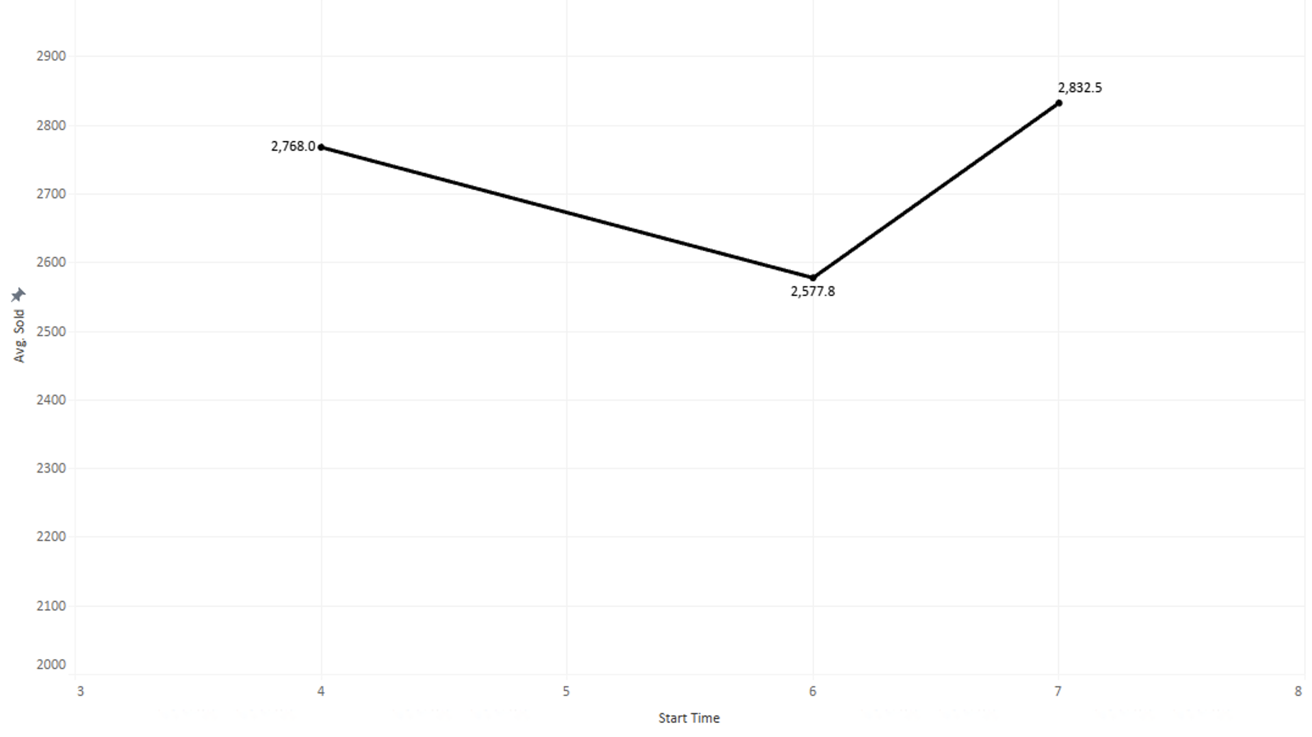
Men's Hockey Ticket Sales
Notes:
Lowell was youth hockey night, ASU was homecoming
LIU – Thanksgiving, UNH – Halloween

Slide 35
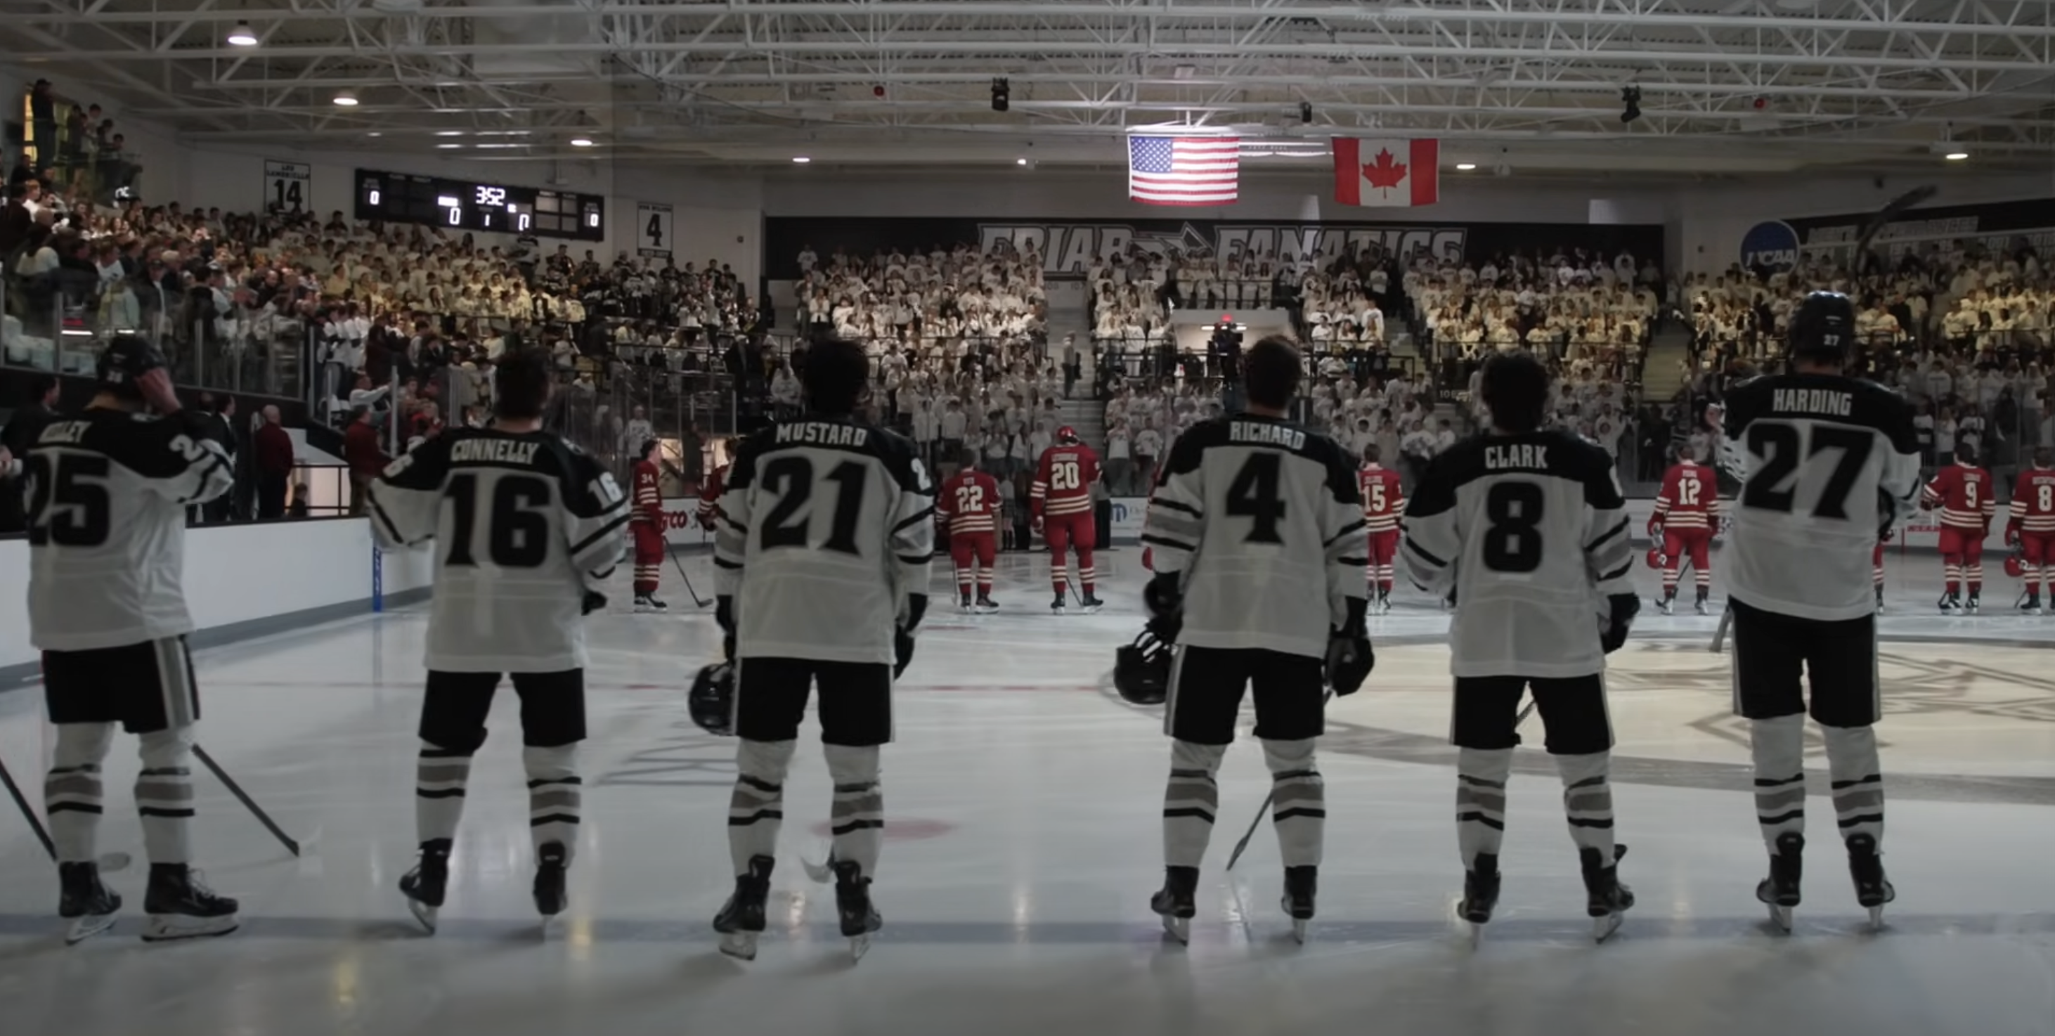
Actions to Improve Men's Hockey Ticket Sales
Attempt to separate rivalry/big opponent games to unique times/days
Try 6PM games in different situations – not just the 2nd of back-to-backs
Attempt increased/ different marketing for back-to-backs
Notes:
Only did 6pm twice – LIU during thanksgiving, UMass which did really well
Ticket discount/reward if scan into both games of a back to back

Slide 36
Priority Actions (Summary)
Rerun start time analysis excluding rivalry games and using prior season's data, then focus on scheduling in line with days / times that optimize tickets sold (MBS) and attendance (WBS, HKY)
Focus on marketing emerging/potential rivals as rivals and keep/increase marketing current conference rivals
Levy fan profiles for targeted family marketing and consider family ticket price promotions
Target customers with specific offers depending on their determined cluster
Increase/differentiate marketing efforts for the second games of Men's Hockey back-to-backs

Slide 37
Questions?

